Slide 1
CP SS19
Work-, Dev-Flow & Architecture

Slide 2
Workflow
Kanban (Backlog, ToDo, In Progress, Done)
Github projects as project mgmt tool
GitHub issues for implementation tasks
Feedback loops as needed
User stories
Regular planning / refinement of stories and issues
GitHub issue templates

Slide 3
Devflow
Simplified GitFlow
Branches: master, feature/…, fix/…, refactor/…
Opening PR into master
Clear and consistent commit messages
Short title: Add, Update, Change, Remove, …
Detailed body if needed
Related issues
At least 1 or 2 reviews before merging
CI checks: linter, tests, ...

Slide 4
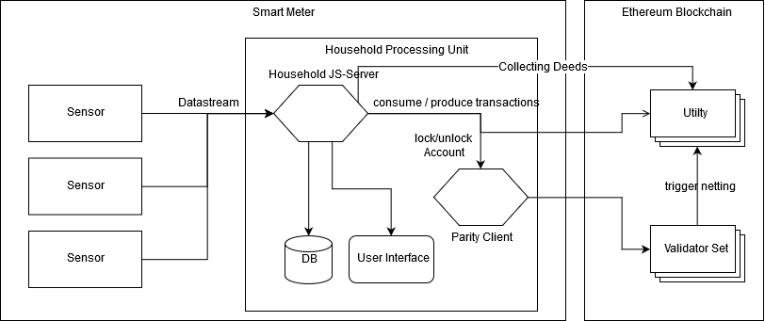
Architecture
Notes:
Changes (2.0 → 3.0)
3 input sensors (consumed, produced, battery)
No shared private key inside the Household Processing unit → HHS asks the parity client to lock/ unlock the account i.o. to send transactions
User interface comunicates with the HHS and not the DB directly → HHS behaves as central middleware inside the Household processing unit
Netting is triggered by the Validator Set
In the future: either one household or every time a block is created via BlockReward (?)

Slide 5
Tech Stack
Mock Sensor - Node.js, REST API (Koa / Express)
Prosumer - Node.js, web3.js / ethers.js, REST API (Koa / Express)
Authority Node - Parity
UI - React
Contracts - Solidity, truffle
DOCKERFILE for each component and docker-compose
Notes:
Where is sensor data stored?
Why proof of wokr? -> Don't forget to mention
Simpler stack prefered
Test workflow ...Before commiting to it

Slide 6
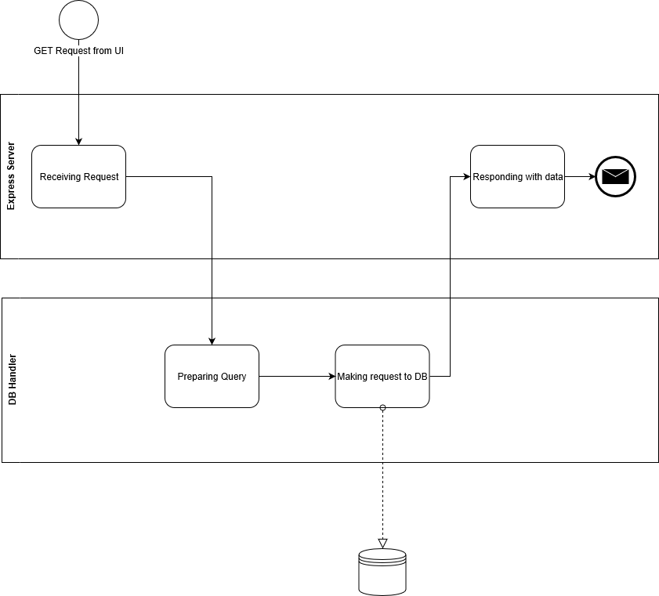
Household Server GET Request from UI

Slide 7
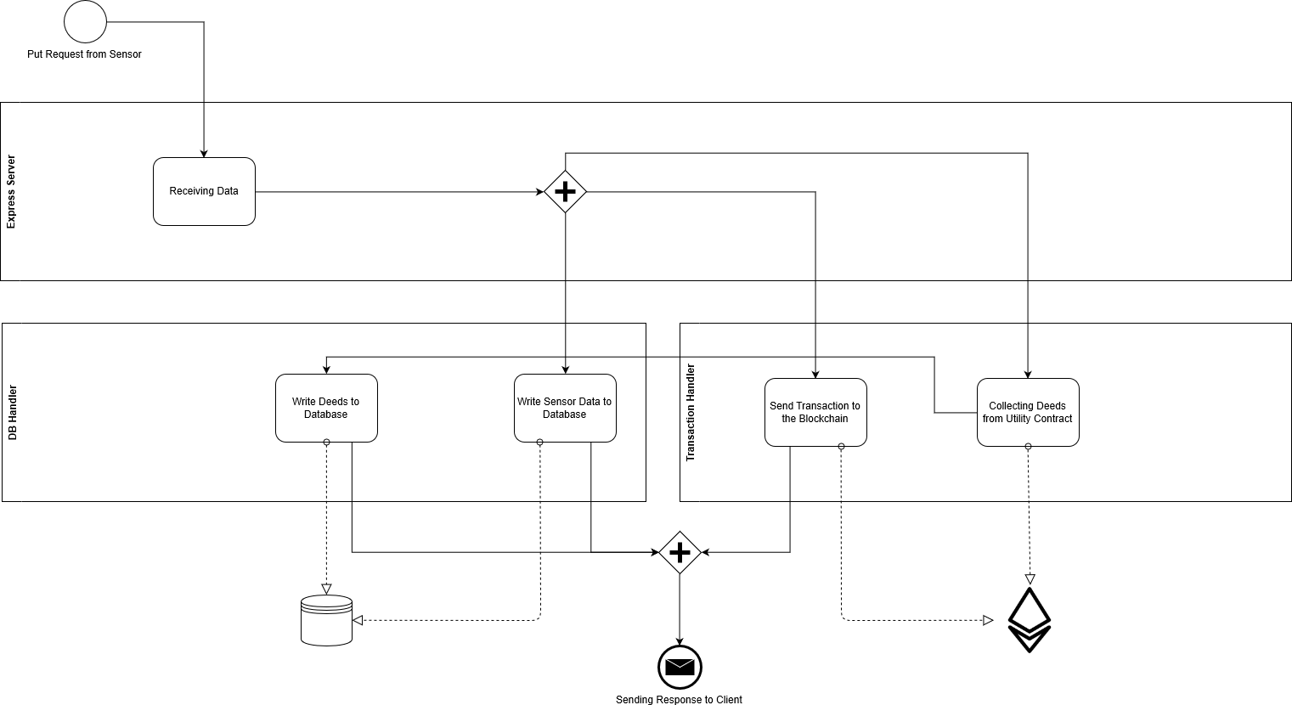
Household Server PUT Request from Sensor

Slide 8
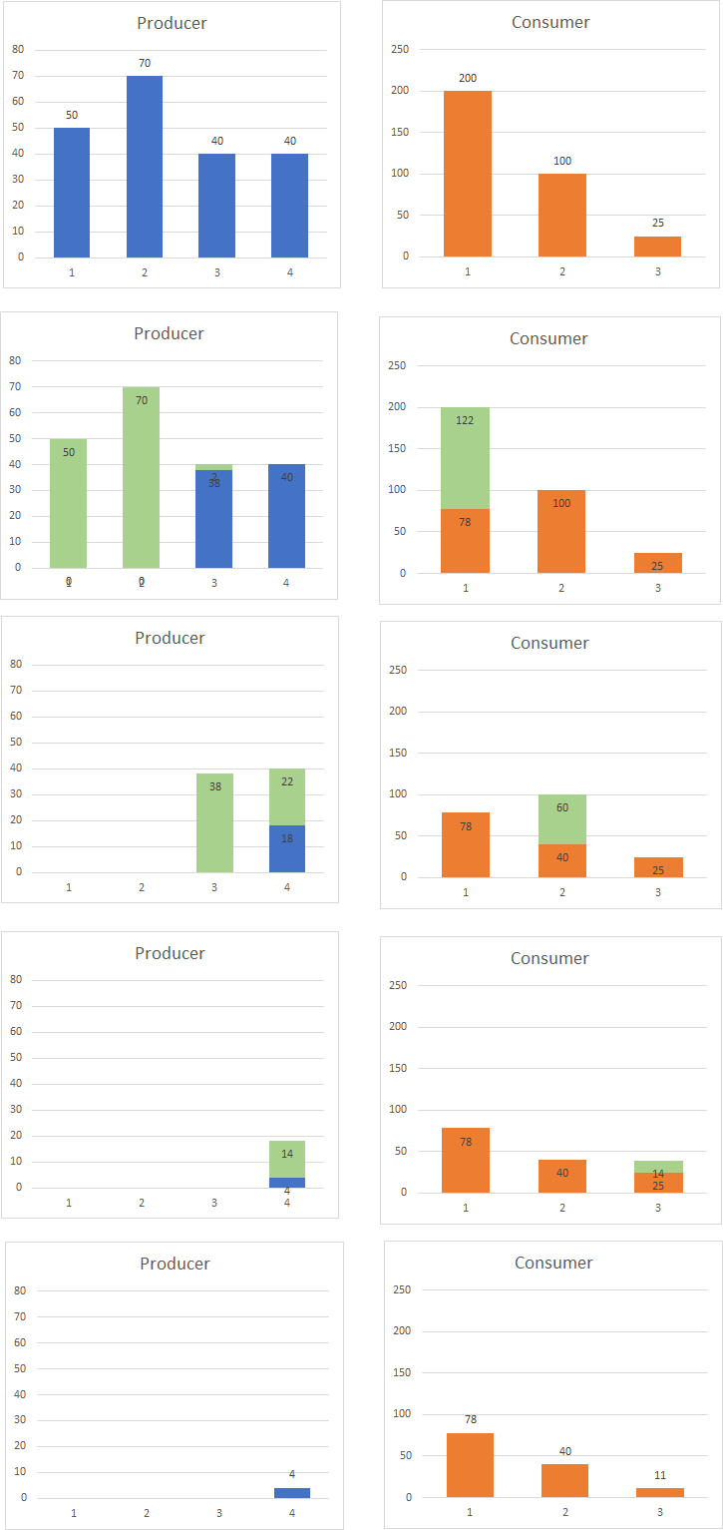
Settlement Algorithm

